Slide 2
Classification of “knowledge”
0-<number>

Slide 3
Types (Categorization) of Knowledge
Knowledge had been classified according to its orientation into :
know-what ……
It is related to having information about facts and state of things
0-<number>
Notes:
Shallow vs. deep (necessary to make decision/solve problem in complex situations)

Slide 4
Know-Why
refers to the understanding of the underlying principles and reasons behind a particular phenomenon or concept. Know-why knowledge is often referred to as theoretical knowledge, as it is based on scientific principles, models, and theories.
Know-why knowledge is essential for developing a deep understanding of a particular topic or domain. It allows individuals to identify patterns, relationships, and cause-and-effect relationships that are essential for problem-solving and decision-making.
0-<number>
Notes:
Example,
in the field of medicine, know-why knowledge is critical for understanding the underlying causes of diseases and developing effective treatments. A doctor who has a deep understanding of the underlying biology of a disease can better diagnose and treat their patients.
Similarly, in the field of engineering, know-why knowledge is essential for designing and building complex systems. Engineers who understand the principles behind the functioning of a system can better optimize its performance and identify potential issues.

Slide 5
know- how
is related to how people understood and how they learn including their physical ability to produce some action, it is called (procedural knowledge)
refers to the practical knowledge and skills that are essential for performing tasks or activities within a particular domain. This type of knowledge is often referred to as experiential knowledge, as it is gained through hands-on experience and practice. Know-how knowledge can be essential for developing expertise and improving performance in a particular area
0-<number>

Slide 6
know- who
which related to who know- what and how.
refers to the knowledge of people and their expertise within a particular domain. This type of knowledge is often referred to as social capital, as it relates to the social relationships and networks that individuals and organizations have within their communities. Know-who knowledge can be essential for finding and accessing information, expertise, and resources that may be critical for problem-solving and decision-making.
0-<number>

Slide 7
Knowledge had been classified according to its importance to the operations into :
The core knowledge
The advanced knowledge
The innovative knowledge
0-<number>

Slide 8
Core Knowledge
Core Knowledge:
Core Knowledge refers to the foundational knowledge that forms the basis of an organization's operations and activities.
It encompasses the fundamental principles, processes, and practices that are essential for the organization's day-to-day functioning.
Examples of Core Knowledge include standard operating procedures, best practices, policies, and basic industry knowledge.
Core Knowledge is typically explicit and well-documented, making it readily accessible to employees across the organization.
Effective management of Core Knowledge involves organizing, categorizing, and ensuring easy access to this information through knowledge repositories, intranets, or collaborative platforms.
0-<number>

Slide 9
Advanced Knowledge:
Advanced Knowledge builds upon Core Knowledge and represents specialized expertise or domain-specific knowledge within an organization.
This knowledge often requires specialized training, experience, or skills beyond the basics.
Advanced Knowledge may include specialized techniques, domain-specific insights, proprietary methodologies, or advanced problem-solving approaches.
Unlike Core Knowledge, Advanced Knowledge may be more tacit in nature, residing within the minds of experts or experienced practitioners.
Capturing and sharing Advanced Knowledge involves techniques such as communities of practice, mentorship programs, expert directories, or knowledge transfer sessions.
0-<number>

Slide 10
Innovative Knowledge:
Innovative Knowledge represents new ideas, insights, or discoveries that drive organizational innovation and competitiveness.
It encompasses novel concepts, cutting-edge technologies, emerging trends, and creative solutions to complex challenges.
Innovative Knowledge often emerges at the intersection of different disciplines, through experimentation, collaboration, and continuous learning.
Unlike Core and Advanced Knowledge, Innovative Knowledge is highly dynamic and uncertain, requiring an environment that fosters experimentation and risk-taking.
Organizations foster Innovative Knowledge by promoting a culture of creativity, encouraging cross-functional collaboration, providing resources for research and development, and rewarding innovation.
0-<number>

Slide 11
Tacit knowledge & explicit knowledge
“ We know more than we can tell”. Polanyi 1966
According to Polani 1966 and Nonaka and Takeuchi (1995) identified the most famous categories of knowledge as
Tacit knowledge & Explicit knowledge
0-<number>

Slide 12

Explicit knowledge
Explicit knowledge
Refers to knowledge that is transmittable in formal, systematic language, which can be captured and shared through information technology so, it is easy to transfer within and between people
0-<number>

Slide 13
Any organization supposes to obtain three types of explicit knowledge;
Cognitive knowledge ; the basic discipline that professionals achieve through extensive training and certification
Advanced skills ; the ability to apply rules of a discipline to complex real- world problem.
System understanding ; the deep understanding of the web of cause – and effect relationships underlying a discipline
0-<number>

Slide 14

Tacit knowledge
Tacit knowledge; resides in the human mind, behavior, and perception
It is derived empirically and held by the organization's employees
It is hidden and refers to; intuitions and insights
0-<number>

Slide 15
Implicit knowledge
Although the view of knowledge as tacit and explicit is well known to date and involved in the majority of current literature on organizational knowledge
Some scholars advocated that knowledge shouldn't seen as two separate types of knowledge.
They suggested that all knowledge has both tacit and explicit components, and knowledge exists along a continuum of tacitness and explicitness
For this reason it is existed a middle ground between tacit and explicit knowledge termed implicit knowledge that refers to the subset of tacit knowledge that can be transformed into explicit
0-<number>

Slide 16
Basic distinction between tacit and explicit knowledge
Tacit Knowledge | Explicit Knowledge
Tacit knowledge is hidden and refers to intuitions experiences and insights. | Explicit knowledge can be articulated and codified items
Tacit knowledge dissemination is difficult and only happens through people | Explicit knowledge dissemination is easy and can happen through information technology
Tacit knowledge is personal, and can be easily lost if the key people of organizations leave them | Explicit knowledge is impersonal, so it can be stacked through the organizational memories.
Tacit knowledge can be found in the form of values, ideas, beliefs, insight and innovation | Explicit knowledge can be found in the form of rules, policies, procedures, researches and manuals
Tacit knowledge has more significance as a potential source for innovation and competitive advantage | Explicit knowledge has less significance as a source for innovation and competitive advantages
0-<number>

Slide 17

What makes someone an expert?
An expert in a specialized area masters the requisite knowledge
The unique performance of a expert is clearly recognizes in decision-making quality
Knowledgeable experts are more selective in the information they acquire
Experts benefit from the knowledge that comes from experience
0-<number>

Slide 18

Expert’s Reasoning Methods
Reasoning by analogy: relating one concept to another
Formal reasoning: using deductive or inductive methods
Case-based reasoning: reasoning from relevant past cases
0-<number>

Slide 19


Deductive and inductive reasoning
Deductive reasoning
Access to the special cases of generalities
:Inductive reasoning: Reasoning from a set of facts or individual cases to a general conclusion
0-<number>

Slide 20
A classic example of reasoning, given by Aristotle, deductive is
All men are mortal. (major proposition )
Socrates is a man. (minor proposition)
Socrates is mortal. (conclusion)
0-<number>

Slide 21
An example of inductive
Most wheels I have seen are round
Most birds I have seen could fly
We can infer general propositions like:
All wheels are round.
All birds can fly.
0-<number>

Slide 22

Human’s Learning Models
Learning by experience: a function of time and talent
Learning by discovery: undirected approach in which humans explore a problem area with no advance knowledge of what their objective is.
Learning by doing: the most efficient model
0-<number>

Slide 23
Knowledge Management

Slide 24
Learning Objectives
Gain an introduction to the field of KM.
Understand Why do we have to manage knowledge.
Understand the role of KM in today’s organization.
Determine the different perspectives of KM.
Define the classification of Knowledge Management Systems
Understanding the nature of knowledge
0-<number>
Notes:
First, I will overview the objectives for Part 1 of today’s lecture.
First, definition.
Second, need.
Third, function.
Fourth, put in practice.
Fifth, different manifestations.
Sixth, factors important to effective KMS.
First, what is knowledge management? Some of you might have previewed the lecture notes or the prescribed textbook, or just off the top of your head, what do you think Knowledge management is and what it involves?
[Ask one to two students]
Here, we want to understand what KM is and what are the driving forces behind KM projects/initiatives in today’s organization (big or small). In other words, the needs that KM is trying to address.
We hear about data management, or information management, and now Knowledge management? In terms of levels, knowledge is at the highest that is essential for decision making. It is more than simply data or information.
Second, we want to discuss the main issues that organizations will face when they consider the adoption of KM.
Third, we want to understand what constitute a KMS and its role and the functions it will provide to an organization.
Fourth, we will discuss the relevance of KM in today’s dynamic business environments that are fueled by the advancement of technologies.
Finally, we will consider both benefits and concerns when developing KM projects from an IT perspective.
KMS is not simply looking at the technical issues like we do in information processing systems. It involves people, including the experts, the knowledge developers, the users and of course importantly the management. Has anyone heard about a term CKO (Chief Knowledge Officer)? He is the one who is in a managerial position overseeing the management of organizational knowledge for the benefit and growth of the organization.

Slide 25
The importance of knowledge
Cases
0-<number>

Slide 26
Case One
In one company, the financial manager decided to reduce the budget by laying off some employees . One of them was the best maintenance engineer.
After some months, one machine stopped working due to damage of some parts
the company tried many times to fix it, but it could not. So it is forced to engage the engineer himself to repair that machine .
Actually the engineer installed that part using his hammer for the convenience of the new part and put it in the right position so he returned the machine to work in minutes.
After that he made a repair bill of $ 1000. However , the cost of the hammer by the engineer installed did not exceed one dollar?
Can the company justify ($ 999)!...
0-<number>

Slide 27
Case Two
A financial firm faced complex problems due to the mistakes in mathematical calculations in the lump sums of retirees pensions since the exit of their financial manager of pensions.
After the mistakes in the calculations, many problems happened in relation to taxes and funds with many other companies and banks.
In the attempt to solve these problems, several committees were formed, which yielded no results, the company then decided to outsource management of their pension scheme to solve the prevailing issue to their ex financial manager who was able to solve the problems within three days
After that, he submitted an invoice $ 5,000, and when he asked about the actual amount used to accomplish the task within the 3days it was $ 500 only
Can the company justification for ($ 4,500)! Could they have done anything better?
0-<number>

Slide 28
Knowledge Management
Knowledge management (KM) is the process of creating, capturing, sharing, using and effectively managing and utilizing knowledge in an organization to achieve its objectives.
The goal of KM is to improve organizational performance by enabling better decision-making, innovation, and learning.
0-<number>
Notes:
Knowledge management (KM) is the process of capturing, organizing, sharing, and effectively utilizing knowledge in an organization to achieve its objectives.

Slide 29
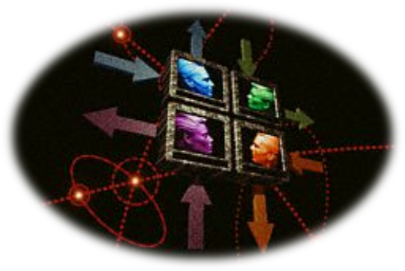
What is Knowledge Management?
(KM) may be defined simply as doing what is needed to get the most out of knowledge resources.
(KM) focuses on organizing and making available important knowledge, wherever and whenever it is needed.
(KM) is highly related to the concept of intellectual capital (both human and structural.
0-<number>
Notes:
So, What is knowledge management?
Can someone give it a try, to say what is KM in your opinion?
[One to two students]

Slide 30
Why do we have to manage knowledge?
Organizations face many challenges in managing knowledge, such as knowledge loss due to employee turnover, silos of knowledge, and the complexity of managing knowledge in a digital age.
KM helps organizations to capture and preserve institutional knowledge, share knowledge across different departments, and create a learning culture that fosters innovation and creativity.
KM also enables organizations to be more responsive to changing customer needs and market trends, by providing a more agile and flexible approach to decision-making
0-<number>

Slide 31
Changes in strategic direction may result in the loss of knowledge in a specific area.
Early retirements and increasing mobility of the work force lead to loss of knowledge.
0-<number>

Slide 32
Forces Driving Knowledge Management
Increasing Domain Complexity due to Globalization
Accelerating Market instability
Intensified Speed of Responsiveness
Diminishing Individual Experience
0-<number>
Notes:
There is also a trend towards more complex problem-solving services where the
majority of employees are well-educated and creative, self-motivated people.
Employees’ roles and their relationships to organizations are changed dramatically
as information or knowledge workers replace industrial workers as the largest
group of the work force.
Knowledge as the key resource, not labor, raw material or capital, changes production functions in organizations
significantly.
The transformation of society into a knowledge society has changed valuation of knowledge work dramatically. In the beginning of the twenty-first century, it is no longer natural resources (especially oil) that creates money, but knowledge. Today, for the first time in history, the
world’s wealthiest person, Bill Gates, is a knowledge worker (Thurow 1997, 96).
If you were in a decision-making process as to whether KM should be introduced into your organization,
what would the relative weights you might place on these driving forces? Why?
[One to two students]
Clip [4]
As a manager who is to decide on whether to introduce KM in your organization, what are the relative weights you might place on these driving forces? Why?
Take a few minutes to think about this? And share.

Slide 33
Increasing Domain Complexity due to Globalization
Globalization has increased the complexity of business operations for organizations. Globalization has led to increased competition, the need to comply with multiple regulatory frameworks, and the need to manage diverse teams and cultures.
Example:
In the automotive industry, globalization has led to increased competition and the need to comply with various regulatory frameworks. With the complexity of managing a global supply chain, there is a need to implement KM practices to manage knowledge related to suppliers, regulations, and processes
In the software industry, globalization has led to the need to manage distributed teams across multiple time zones and cultures. With the complexity of managing these teams, there is a need to implement KM practices to manage knowledge related to project management, team collaboration, and communication
0-<number>
Notes:
Example: In the software industry, globalization has led to the need to manage distributed teams across multiple time zones and cultures. With the complexity of managing these teams, there is a need to implement KM practices to manage knowledge related to project management, team collaboration, and communication.
d) Example: In the pharmaceutical industry, globalization has led to the need to comply with regulatory frameworks in different countries. With the complexity of managing regulatory compliance, there is a need to implement KM practices to manage knowledge related to regulatory compliance, product development, and supply chain management.

Slide 34
Market Instability
Market instability refers to the unpredictable and rapid changes that occur in the business environment. These changes can be caused by factors such as competition, changes in consumer behavior, and changes in technology.
Example: In the retail industry, companies face market instability due to changing consumer preferences and technological advancements. Retailers need to implement KM practices to quickly adapt to changes and remain competitive.
0-<number>

Slide 35
Diminishing Individual Experience:
Definition: Individual experience refers to the knowledge and skills possessed by an individual employee. When experienced employees retire or leave the organization, their knowledge and skills leave with them, creating a knowledge gap in the organization.
Example: In the manufacturing industry, experienced employees possess knowledge and skills that are critical to the organization's operations. With the retirement of these employees, there is a need to capture and manage their knowledge to ensure business continuity.
0-<number>

Slide 36
Digitalization and Aging Workforce:
Digitalization refers to the increasing use of digital technologies in organizations. With the aging workforce, there is a need to implement KM practices to ensure that knowledge is effectively shared and utilized across different generations of employees.
Example: In the banking industry, the increasing use of digital technologies has led to the need for employees to possess digital skills. With an aging workforce, there is a need to capture and manage the knowledge of older employees and transfer that knowledge to younger employees.
0-<number>

Slide 37
High Employee Turnover:
Definition: Employee turnover refers to the rate at which employees leave an organization. High employee turnover can create a knowledge gap in the organization.
Example: In the hospitality industry, high employee turnover can lead to the loss of knowledge related to customer preferences and organizational culture. There is a need to capture and manage this knowledge to ensure the continuity of business operations.
0-<number>
Notes:
During the 1980, downsizing was the popular strategy to reduce overhead costs and increase profits; however, the downside to being “lean and mean “soon became evident .Over time a successful downsizing strategy led to important knowledge has been lost , as employees left and took the knowledge that they had accumulated over the years with them , this led management to undertake a KM as a tool to retain and keep on employees’ knowledge and experts for a long time. By the way organizations have been more interested in using the more advanced IT to capture employees’ knowledge and disseminate it within and between organizational units to be more satisfied.

Slide 38
Why KM is important ?
Knowledge management provides benefits to individual, to communities of practice, and to the organization itself.
0-<number>

Slide 39
For the individual, KM:
Helps people do their jobs and save time through better decision making and problem solving
Helps people to keep people informed and up to date
0-<number>

Slide 40
For the communities of practice, KM
Communities of practice (CoPs) are groups of individuals who share a common interest or expertise and work together to create and share knowledge. CoPs are a key concept in organizational science and have been used to understand how knowledge is created and shared within organizations
Develops professional skills
Promotes peer-to-peer mentoring
Facilitates more effective networking and collaboration
Develops a professional code of ethics that members can adhere to
Develops a common language
0-<number>
Notes:
Communities of practice (CoPs) are groups of individuals who share a common interest or expertise and work together to create and share knowledge. CoPs are a key concept in organizational science and have been used to understand how knowledge is created and shared within organizations.

Slide 41
For the organization, KM
• Helps drive strategy
• Solves problems quickly
• Diffuses best practices
• Improves knowledge embedded in products and services
• Cross-fertilizes ideas and increases opportunities for innovation
• Enables organizations to better stay ahead of the competition
• Builds organizational memory
0-<number>

Slide 42
Origins of Knowledge Management (KM)
Theoretical roots of KM , there are a variety of that has informed the field of KM for example:-
Organization Science;
  Communities of practice (CoPs) are groups of individuals who share a common interest or expertise and work together to create and share knowledge. CoPs are a key concept in organizational science and have been used to understand how knowledge is created and shared within organizations.
0-<number>
Notes:
Examples of CoPs in practice include professional associations, online forums, and informal networks within organizations.

Slide 43
Accounting; A relationship between the KM and accounting is determined by the movement of intellectual capital (IC) which focuses on the importance measurement of knowledge.
In the 1980s and 1990s, accounting experts began to recognize that the value of organizations was increasingly tied to their intangible assets, such as knowledge, rather than their tangible assets.
0-<number>
Notes:
Experts: Baruch Lev, a professor of accounting at New York University, is considered one of the pioneers in linking accounting to knowledge management. He has written several books on the subject, including "Intangibles: Management, Measurement, and Reporting," which explores the role of intangible assets in accounting..

Slide 44
Human Resource Management;
HRM is playing the important role in growing KM field through the concept of knowledge works and knowledge worker .
Human resource experts have recognized that knowledge workers, i.e., employees who are highly skilled and possess specialized knowledge, are critical to an organization's success.
0-<number>
Notes:
Peter Drucker, a management consultant and author, is known for coining the term "knowledge worker" in his 1959 book "Landmarks of Tomorrow." He argued that knowledge workers were the key to the success of organizations in the future. Thomas Davenport, a professor of information technology and management at Babson College, is another expert who has written extensively on knowledge workers and the role of human resources in managing them.

Slide 45
Information technology ;
With the advent of the internet and other digital technologies, the amount of information available to organizations has increased dramatically. This has led to the need for organizations to manage their information and knowledge resources more effectively.
KM is depending mainly on IT applications to support the km processing .The most common type of initative was building repositories of specific type of knowledge for use in particular business functions .
Beside the implementation of IT application, there are many specific roles and positions created to advance KM agenda in organizations.
An example designing knowledge architectures, and redesigning knowledge work process and activities. The following figure can summarize the main root of KM.
0-<number>

Slide 46
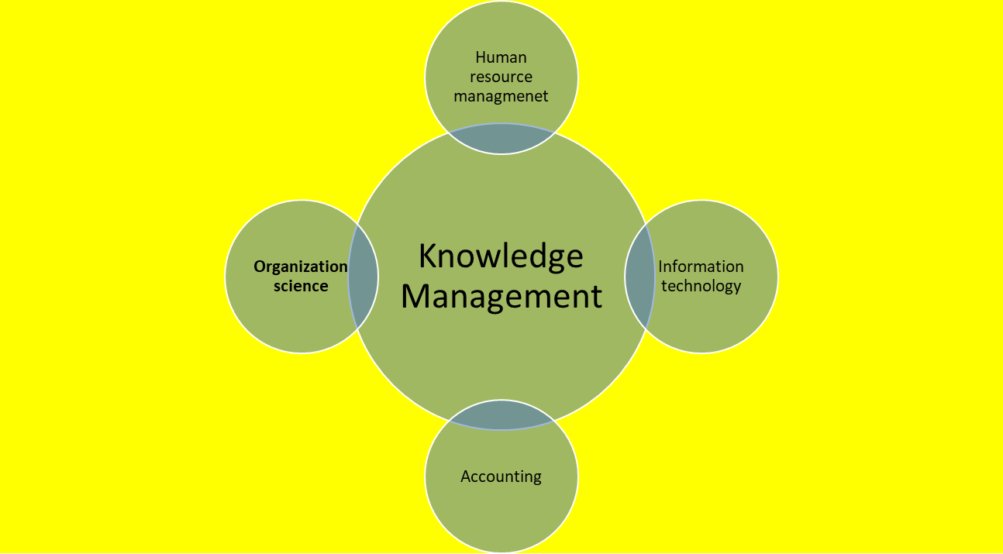
The Theoretical roots of KM
0-<number>

Slide 47
Empirical roots of KM
Two fundamental shifts are essential for emerged KM;
Downsizing
During the 1980, downsizing was the popular strategy to reduce overhead costs and increase profits; however, the downside to being “lean and mean “soon became evident .Over time a successful downsizing strategy led to important knowledge has been lost , as employees left and took the knowledge that they had accumulated over the years with them , this led management to undertake a KM as a tool to retain and keep on employees’ knowledge and experts for a long time. By the way organizations have been more interested in using the more advanced IT to capture employees’ knowledge and disseminate it within and between organizational units to be more satisfied.
0-<number>

Slide 48
2- Technology development
The technology development has highlighted the interest in KM through two main sources; the explosive growth of information resources such as (the internet) and the accelerating pace of technological change. i.e, Artificial intelligence
The recent IT development has affected both the lives of people and organizations. Thus KM is an attempt to cope with the explosion of information and to capitalise on increased knowledge in the workplace.
On the other hand, the emerging technological development enables global sharing of information across different countries, and can serve a tool within an organization to use knowledge more effectively.
0-<number>
Notes:
Another important influence on knowledge management was the development of artificial intelligence and knowledge-based systems in the 1980s and 1990s. These systems were designed to capture and utilize expert knowledge within organizations, leading to a renewed interest in knowledge management and its potential for improving organizational performance.

Slide 49
Understanding Knowledge
Philosophical Perspectives on Knowledge
Part One

Slide 50
What is knowledge ?
As an essential part of KM is, of course, knowledge , so
In order to comprehend knowledge management, it is necessary first to understand the concept of knowledge. What is knowledge?
0-<number>

Slide 51
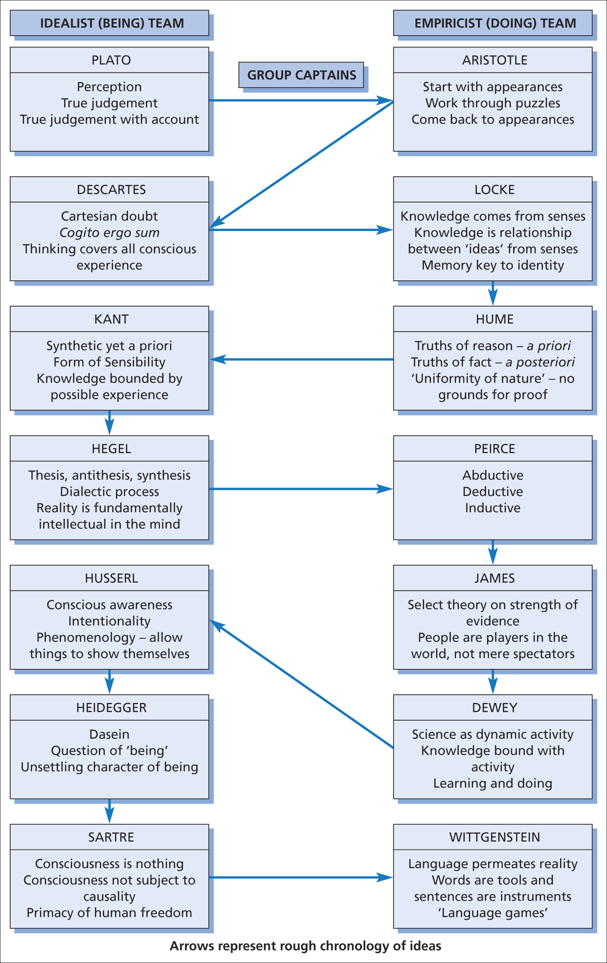
THINKERS ON KNOWLEDGE ACROSS HISTORY
Figure 2.1 Idealist and empiricist perspectives on knowledge
0-<number>

Slide 52
PLATO (427–347 BC) –
Greek philosophers
Addressed knowledge as
“Justified True Belief “
0-<number>

Slide 53
ARISTOTLE (384–322 BC) –
THE METAPHYSICS
Start with ‘appearances’ – ordinary believes
Work through puzzles (contradictions and find central beliefs)
Come back to ‘appearances’ with better understanding
0-<number>

Slide 54
DESCARTES (1596–1650) – MEDITATIONS
Lay aside things on common-sense grounds that are doubtful
Doubt you are recognizing or perceiving anything at any moment
0-<number>

Slide 55
BUZZ GROUP
Which philosopher has the greatest influence on your thinking?
0-<number>

Slide 56
What is Knowledge ?
0-<number>

Slide 57
Knowledge
A great deal of conceptual challenge derives from the fact that a word such as knowledge is necessarily subjective in nature,
not to mention value in interpretation.
0-<number>

Slide 58
Definition of knowledge
The definition of knowledge is extremely challenging :-
Davenport & Prusak (1998 ) defined knowledge as “ A Mix of experiences, values , information and expert insight that provides a framework for evaluating and creating new experience and information”
0-<number>

Slide 59
Brooking (1999 ) defined knowledge as “Information in context with understanding on how to use it”.
0-<number>

Slide 60
Knowledge also defined as
“ A meaning resulting from using the available information in high subjective context; that’s why the variances in meaning among people on the same things “
0-<number>

Slide 61
Data, Information, and Knowledge
How is knowledge different from information?
and how is information different from data?
0-<number>

Slide 62
Data
?
Data is Unorganized and unprocessed facts; it can be considered as the basic or the raw material for creating information ,it is a set of discrete facts about events.
Data is a number, word or letter without any context. For example, numbers like 5 or 100, without any context, are mere data. these numbers or data are meaningless points. It is called “out of context”.
For example, movie listings; giving the times and locations of all movies being shown today.
0-<number>

Slide 63
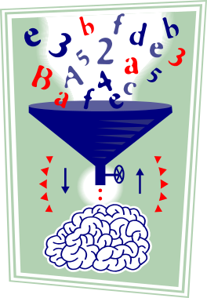
Information
In contrast to data information ; refers to a context, and considered as messages or news created by the interpretation of data, this information can be understood and has meaning by the receiver .
It can defined as aggregation of data that makes decision making easier
ex. most of the film movie listings are drama films .
0-<number>
Notes:
Note the level becomes more abstract as we go from data, to information, and to knowledge.
It is the knowledge that we have that enables us to make decisions.

Slide 64
Knowledge
Is derived from information in the same way information is derived from data; it is a person’s range of information
knowledge involving the processing, creating, or use of information in the mind of individual, which mean that information has little value and will not become knowledge until it is processed by human mind.
I'll watch a movie that I know heroes
0-<number>

Slide 65
Relationship between data, information and Knowledge
Knowledge
Value
Zero
Low
Medium
High
Very High
Data
Information
0-<number>

Slide 66
An illustration
Knowledge
p_{H} = n_{H}/(n_{H}+n_{T})
p_{T} = n_{T}/(n_{H}+n_{T})
EV=p_{H} R_{H}+ p_{T} R_{T}
Counting
H T H T T
H H H T H
…
T T T H T
n_{H} = 40
n_{T} = 60
p_{H} = 0.40
p_{T} = 0.60
R_{H} = +$10
R_{T} = -$8
EV = -$0.80
Data
Information
Value
Zero
Low
Medium
High
Very High
0-<number>

Slide 67
Relating Data, Information, and Knowledge to Events
Knowledge
Data
Data processing
Information
Knowledge
Use of
information
Decision
Events
0-<number>

Slide 68
Exercise
As you are a traditional management student, which of the following statements would you describe as data, information or knowledge?
A report on career progression prospects of MBA students.
An Excel spreadsheet with questionnaire data on MBA students
Critical success factors on interview success with your favored company
A visit to an art exhibition
The latest figures on unemployment
The content list of your KM book.
Travel to England at Christmas
0-<number>

Slide 69
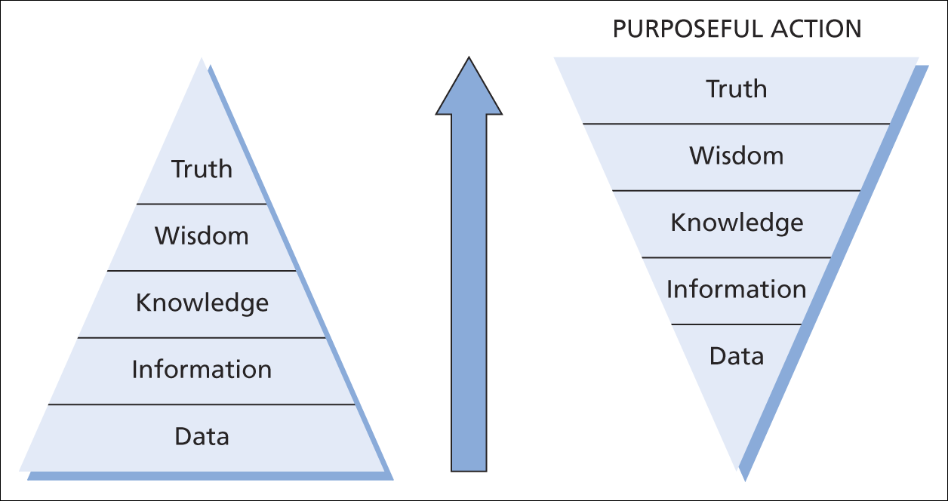
DATA, INFORMATION & KNOWLEDGE
Figure 1.4 Data, information, knowledge and purposeful action
0-<number>

Slide 70
WISDOM
knowing how to use information, it presents an integration of all aspects of the personality including affects, willing, cognition, and life experience
0-<number>

Slide 71
WISDOM
Children have more need of models than of critics (French)
You can’t see the whole sky through a bamboo tube (Japanese)
There is plenty of sound in an empty barrel (Russian)
Trust in Allah, but tie your camel (Muslim)
Wonder is the beginning of wisdom (Greek)
0-<number>

Slide 72
Significant implication of this view of knowledge is that for individuals to arrive at the same understanding of data or information they must share a history or context.
KM can play a collaboration role by which employees can be able to assign meaning to information and data they also can capture and swap some of their knowledge with each other.
0-<number>

Slide 73
Exercise:
Sharing knowledge
What happened when you shared your colleagues knowledge
?
0-<number>

Slide 74
The End
0-<number>

